Slide 1
The Microwave Integrated Retrieval System (MiRS): Algorithm Status and Science Updates
Tanvir Islam^{1,2,*}, Sid Boukabara³, Christopher Grassotti^{1,4}, Xiwu Zhan¹, Kevin Garrett^{1,5}, Craig Smith^{1,4}, Pan Liang⁴, Steve Miller²
¹ NOAA/NESDIS Center for Satellite Applications and Research, College Park, MD, USA
² Cooperative Institute for Research in the Atmosphere, Colorado State University, Fort Collins, CO, USA
³ NOAA Joint Center for Satellite Data Assimilation, College Park, MD, USA
⁴ Atmospheric and Environmental Research, Lexington, MA, USA
⁵ Riverside Technology, Silver Spring, MD, USA
*tanvir.islam@noaa.gov
NOAA NESDIS COOPERATIVE RESEARCH PROGRAM (CORP) SCIENCE SYMPOSIUM, NY, USA, 09-10 September 2014

Slide 2
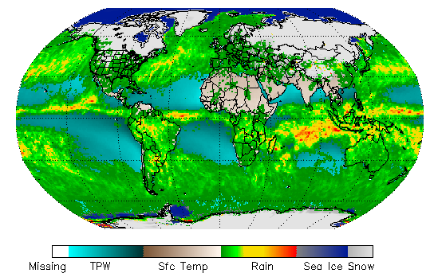
Outline
MiRS overview
Algorithm/Science Improvements
Product Assessments (Improved retrieval)
Applications

Slide 3
MiRS Overview: General Overview (1DVar)
Radiances
First Guess
1DVAR Retrieval
Vertical
Integration &
Post-processing
1st Guess
QC
MIRS Products
All parameters are retrieved simultaneously to fit
all radiances together

Slide 4
MiRS Overview : Product & Post-Processing Flow
Vertical Integration and Post-Processing (VIPP)
Temp. Profile
TPW
RWP
IWP
CLW
Vertical
Integration
Water Vapor Profile
Cloud Water Profile
1DVAR
Outputs
Ice Water Profile
-Sea Ice Concentration
-Snow Water Equivalent
-Snow Pack Properties
-Soil Moisture/Wetness
-Rain Rate
-Snow Fall Rate
-Wind Speed/Vector
-Cloud Top
-Cloud Thickness
-Cloud phase
Rain Water Profile
Post
Processing
(Algorithms)
Emissivity Spectrum
Skin Temperature
Core Products
(State vector)
VIPP

Slide 5
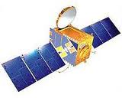
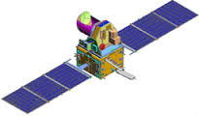
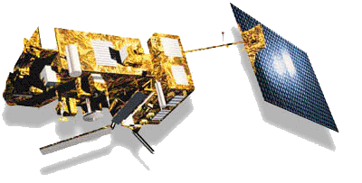
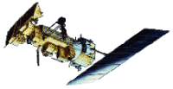
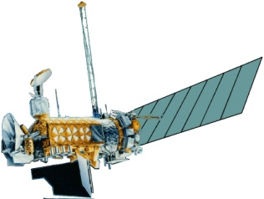
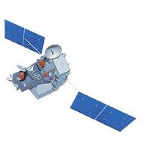
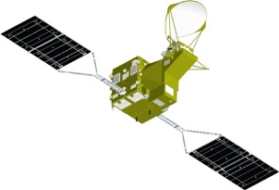
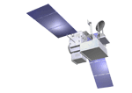
MiRS Overview: Platforms
Megha-Tropiques
SAPHIR/MADRAS
S-NPP ATMS
Inversion Process
Inversion/algorithm consistent across all sensors
Uses CRTM for forward and Jacobian operators
Use fast regression or climatology as first guess/background
Retrieval
All parameters retrieved simultaneously
Valid globally over all surface types
Valid in all weather conditions
Retrieved parameters depend on information content contained in sensor measurements
MetOp-A AMSU/MHS
MetOp-B AMSU/MHS
MiRS
NOAA-18 AMSU/MHS
NOAA-19 AMSU/MHS
DMSP F16 SSMI/S
DMSP F17 SSMI/S
DMSP F18 SSMI/S
TRMM TMI
GPM GMI
GCOM-W1 AMSR2
MiRS can be applied to sounders, imagers and combinations
Same 1DVAR scheme for all platforms (same executables)
Cost to extend to new sensors greatly reduced

Slide 6
MiRS Algorithm: What’s new?
Science improvements
Updated forward modeling capability from pCRTM version to CRTM v2.1.1
Updated microwave sea surface emissivity model (FASTEM-5)
Implementation of a dynamic (spatially and temporally varying) a priori database (“dynamic” background)
Improved retrieval of hydrometeor quantities with a modified physically-based surface rain rate relationship
Some other science improvements (bias correction, bug fixes, etc)
Extension of MiRS to high-resolution: N18, N19, MetopA AMSUA-MHS (existing LR capability in operations)
Extension of MiRS to high-resolution: F17 SSMIS
Extension of MiRS to high-resolution: Megha-Tropiques/SAPHIR
Extended to GCOM-W1 AMSR2 (Research)
In the process of extending for GPM/GMI (Research)
All these capabilities included in MiRS v11

Slide 7
MiRS Algorithm: Mathematical Basis
Cost Function to minimize:
To find the optimal solution, solve for:
- Assuming local Linearity:
- This leads to iterative solution:
Bkg-departure normalized by Bkg Error
Measurements-departure normalized by Measurements+Modeling Errors
Updates to MiRS algorithm

Slide 8
MiRS Algorithm: Detailed Overview (1DVar)
Measured Radiances
Vertical Int. and
Postprocessing
MiRS Algorithm
Yes
Solution
Reached
QC
Simulated Radiances
Comparison: Fit
Within Noise Level ?
No
MiRS
Products
Jacobians
Update
State Vector
Measurement
& RTM
Uncertainty
Matrix E
Initial State Vector
Forward Operator
(CRTM 2.1.1)
New State Vector
Geophysical
Mean
Background
(Dynamic)
Geophysical
Covariance
Matrix B
Climatology/Regression
Algorithm Updated
8

Slide 9
MiRS Highlights in v11 (new release)
HR/Sensors Extension
Science Improvement
Description | Satellites/Sensors Affected | Benefit
Extension to high (MHS) resolution for AMSUA-MHS (LR=30 FOVs/scan, HR=90FOVs/scan) | N18, N19, MetopA/AMSUA-MHS, (MetopB, SNPP/ATMS already high-res) | Improved depiction of small-scale features: CLW, RR, WV, ice edge
Extension to high (ENV) resolution for SSMIS (+extension to F17) (LR=30 FOVs/scan, HR=90FOVs/scan) | F17/SSMIS (and F18, to be delivered early 2015) | Better depiction of small-scale features: CLW, RR, WV, ice edge
Integration of CRTM 2.1.1 (previously using pCRTM) | All: N18, N19, MetopA, MetopB/AMSUA-MHS, SNPP/ATMS, F17, F18//SSMIS (MT/SAPHIR already using CRTM 2.1.1) | Better sync with CRTM development cycle; more realistic ice water retrievals (Jacobians)
New bias corrections for all sensors | All | Needed for consistency with CRTM 2.1.1
Integration of new dynamic a priori atmospheric background | All | Large improvement in T, WV sounding; reduction in average number of iterations; increase in conv rate
Updated hydrometeor/rain rate relationships | All | Improved RR over land and ocean
Updated hydrometeor a priori background profiles | All | Improved RR over land and ocean; improved sounding products in rainy conditions
Dynamic channel selection near sea ice boundary | N18, N19, MetopA, MetopB/AMSUA-MHS, SNPP/ATMS | Better convergence behavior for cross-track instruments
Updated surface type preclassifier | F17, F18 SSMIS | Improved snow detection for conical scan instruments
Miscellaneous changes to improve code efficiency, bug fixes | All | Matrix preparation time reduced from 40% to 5% of 1dvar computation time

Slide 10
Improved MiRS a Priori State: Dynamic Mean Profile, Methodology (using ECMWF 6-hr analyses from 2012)
Spatial sampling
output: 5 deg lat/lon averaging grid: averaged data output to 5 x 5 deg grid
based on 10 degree moving average window (smoothness)
Global Grid 72 x 37 x 100 (NX x NY x NZ)
Moving average windows (10x10 deg) and grid centers (5 deg spacing)
1 deg
1 deg
Temporal sampling:
Unique background for each month and time of day (0, 6 12 18 UTC); based on 5 days evenly spaced within month
Temporal grid 12 x 4 (Nmonth x Nhr)
Additional smoothness within MiRS due to interpolation in space and time to obs location
Variables stored: T, WV, Tskin, CLW
ECMWF grid
0.25 deg

Slide 11
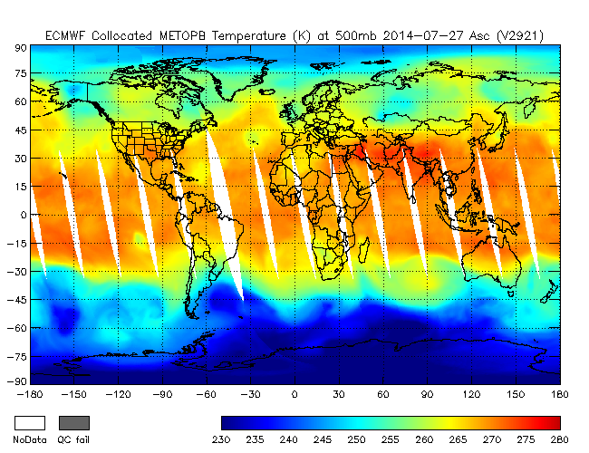
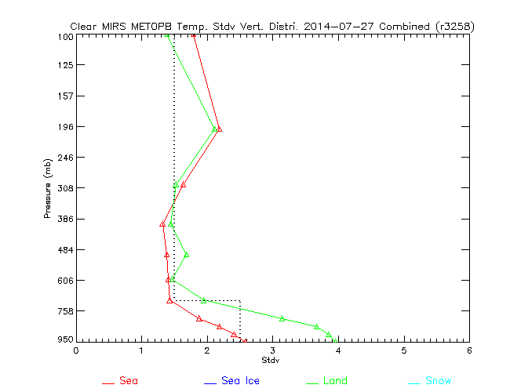
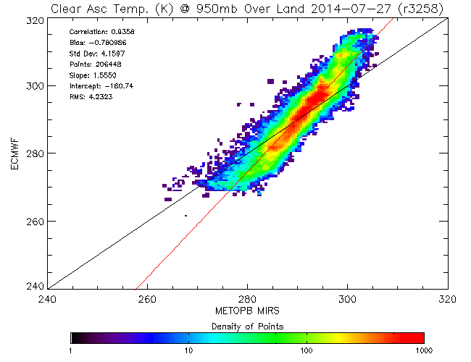
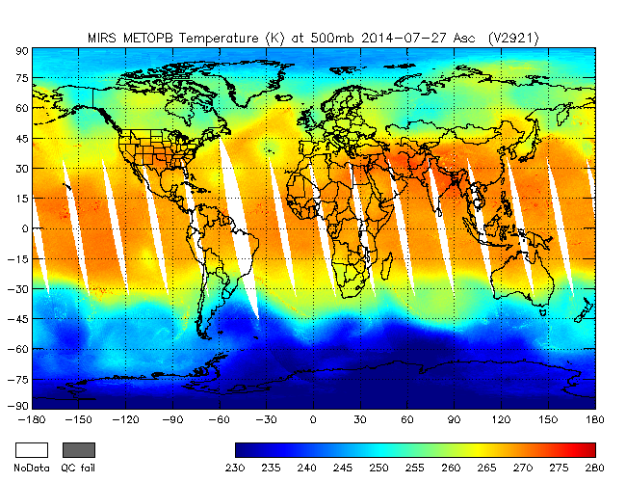
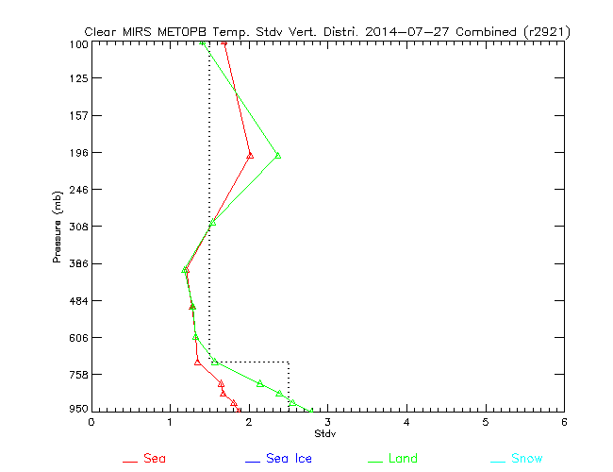
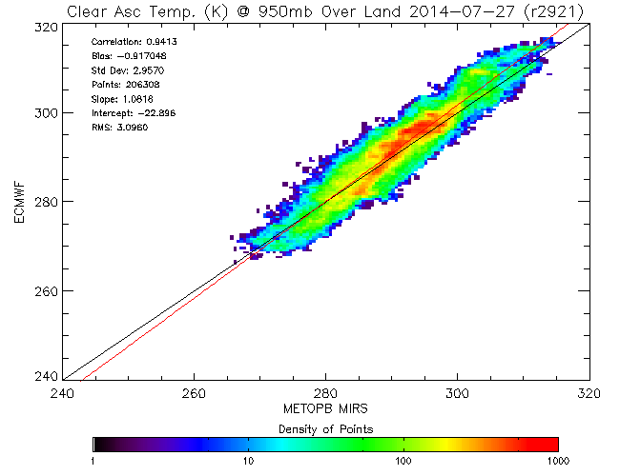
MiRS Product Assessments: AMSUA/MHS Temperature Sounding (Clear)
ECMWF
MiRS MetopB HR v9.2
Std dev
T 950 hPa
Std dev: 4.2 K
MiRS v11
MiRS MetopB HR v11
Std dev
T 950 hPa
Uncertainty
Reduced in v11
Std dev: 3.0 K
__Land
__Ocean
Agrees well with independent ECMWF analysis

Slide 12
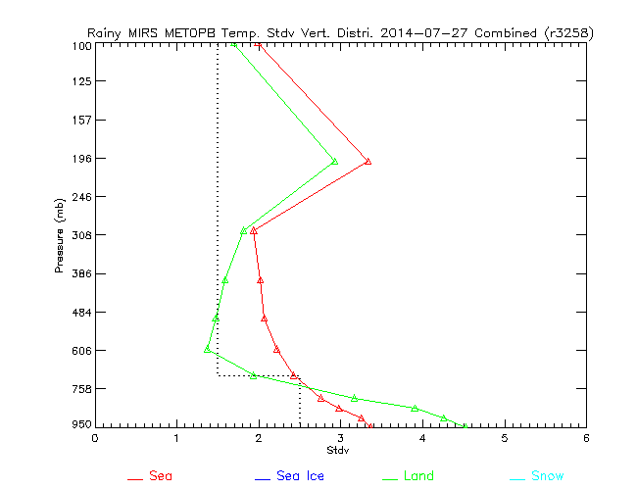
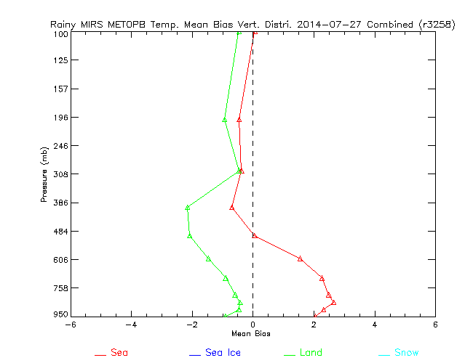
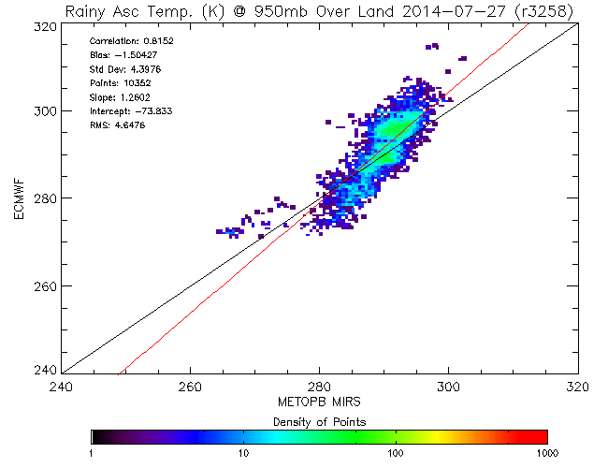
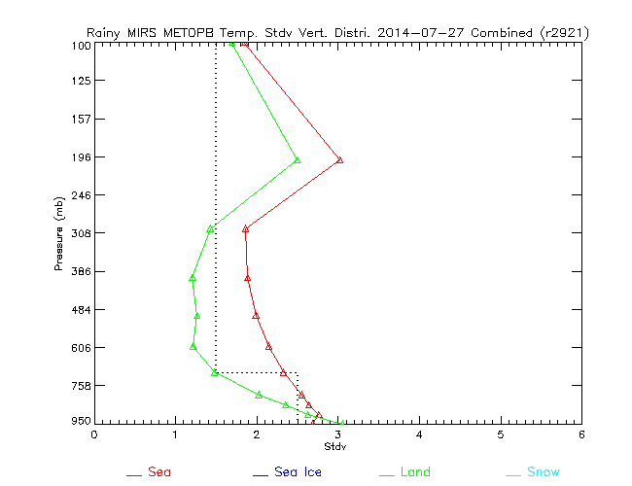
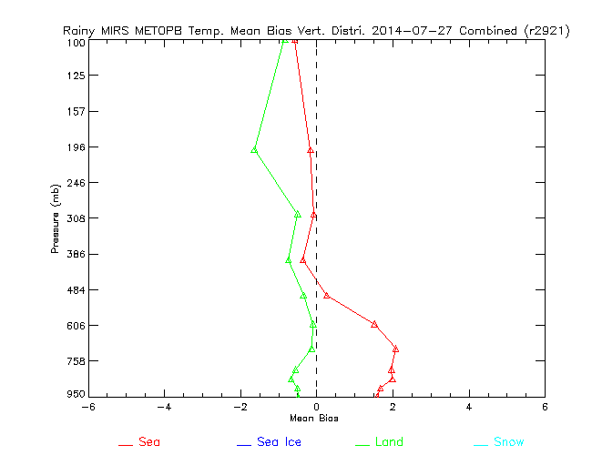
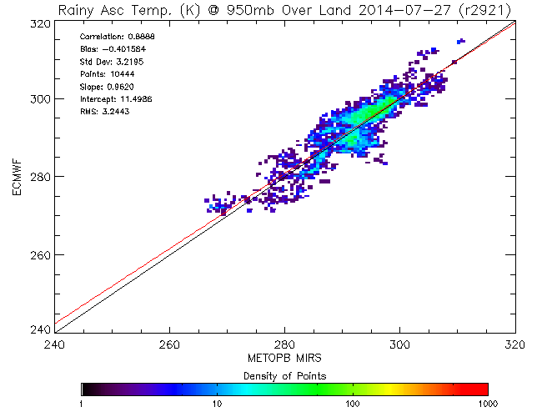
MiRS Product Assessments: AMSUA/MHS Temperature Sounding (Rainy)
MiRS MetopB HR v9.2
Std dev
Bias
T 950 hPa
Std dev: 4.4 K
MiRS MetopB HR v11
Std dev
Bias
T 950 hPa
Both Bias and Stdv
reduced in v11
__Land
__Ocean
Std dev: 3.2 K

Slide 13
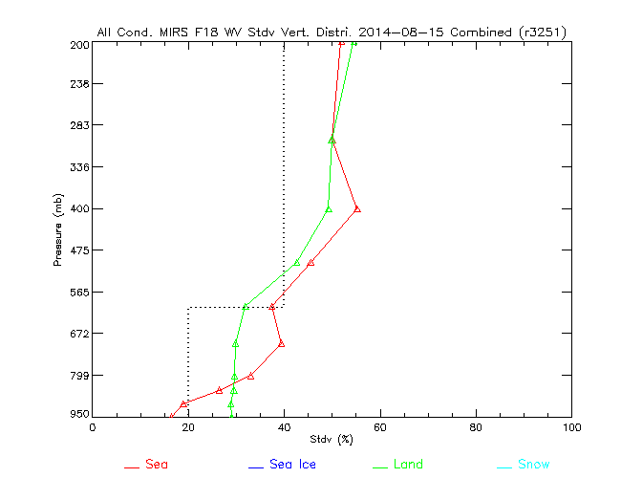
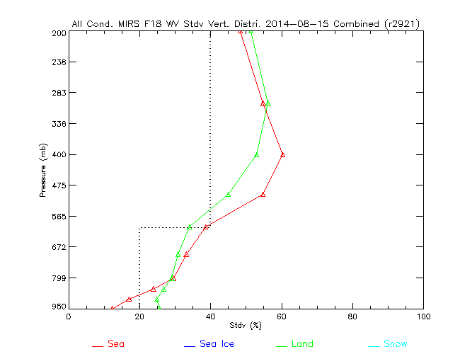
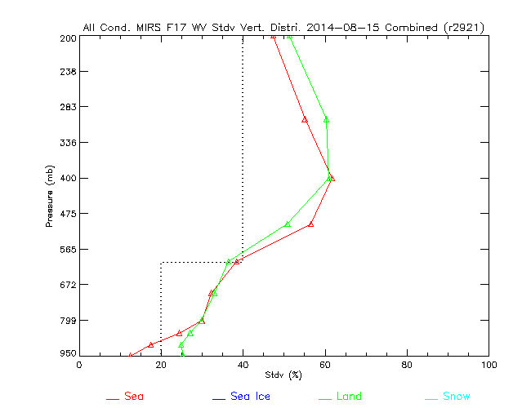
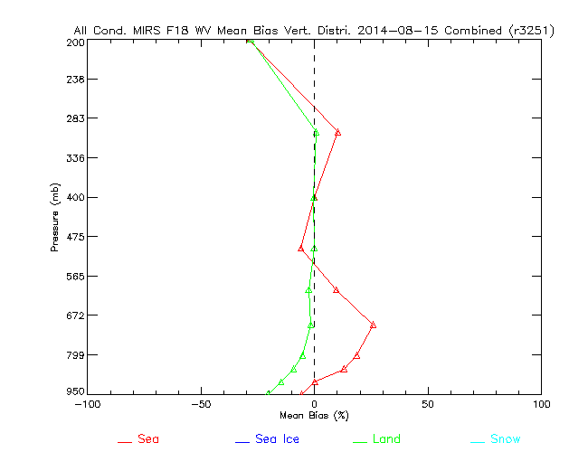
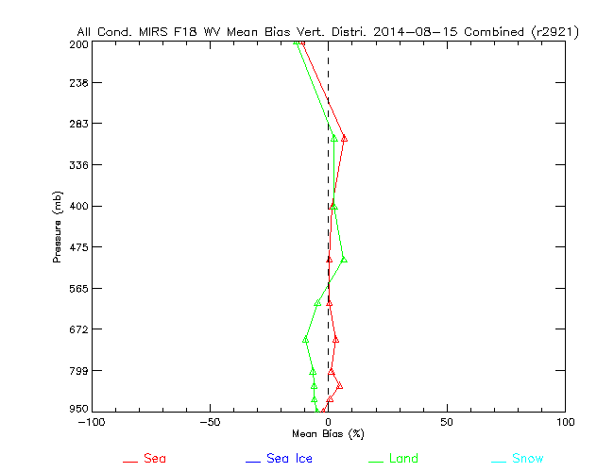
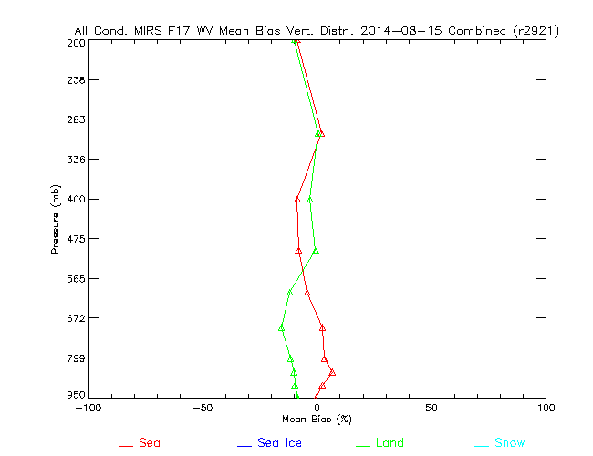
MiRS Product Assessments: SSMIS Water Vapor Sounding
MiRS F18 LR v9.2
MiRS F18 HR v11
MiRS F17 HR v11
Std dev
Improved performance in v11 in lower troposphere
F17 v11 performance is somewhat lower than F18 v11 due to F17 calibration issues
Bias
__Land
__Ocean

Slide 14
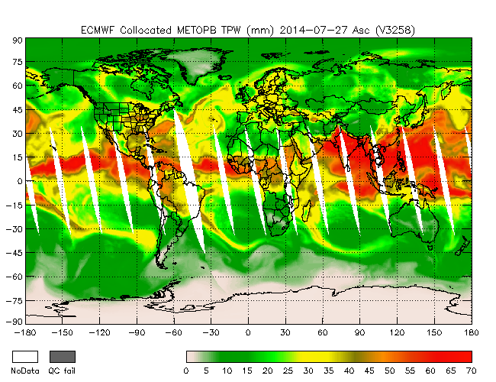
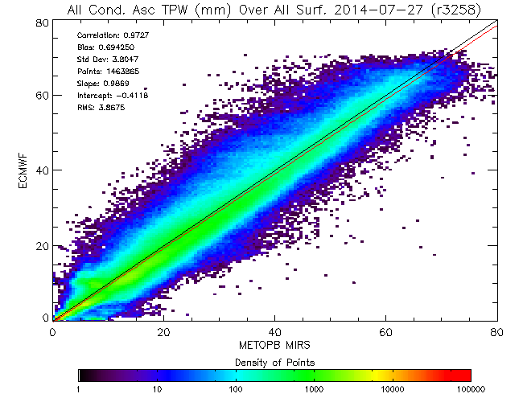
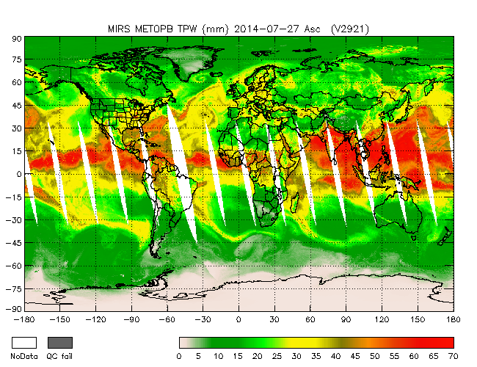
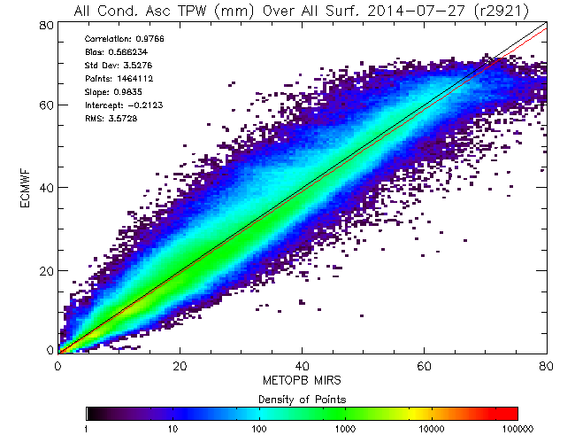
MiRS Product Assessments: AMSUA/MHS TPW
ECMWF
MiRS MetopB HR v9.2
Bias: 0.69
Std dev: 3.80
Both Bias and Std Dev
reduced in v11
MiRS v11
MiRS MetopB HR v11
Bias: 0.56
Std dev: 3.52
Agrees well with independent ECMWF analysis

Slide 15
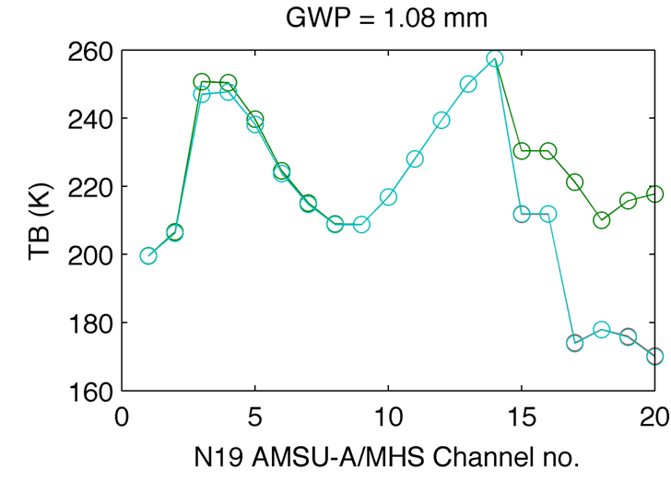
MiRS/CRTM handling of Ice Scattering
CRTM n_stream sensitivity
(impact on IWP)
MiRS v9.2 uses n_stream=2
MiRS v11 uses n_stream=4
TB simulation for different AMSU/MHS channels using n_streams 2 and 4 in CRTM 2.1.1
50K difference
between
n_stream 2 and 4/6
At 190 GHz
n_stream=2 and n_stream=4 have significant differences in TB simulation for high-freq channels (where scattering is larger)
use of n_stream = 2 is not accurate enough with CRTM 2.1.1
less iterations, lower chisq, and better fit to TBs in v11 using n_streams = 4 (only slight increase in overall computational cost.
n_st = 2
n_st = 4

Slide 16
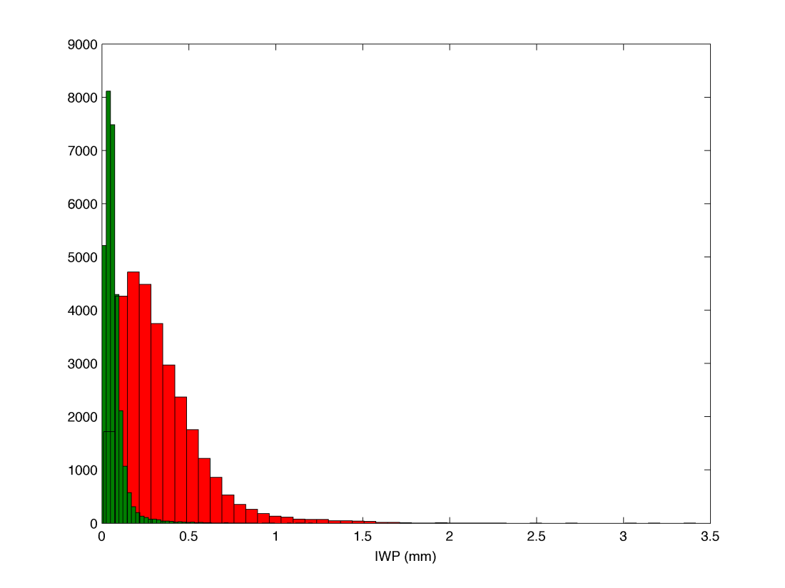
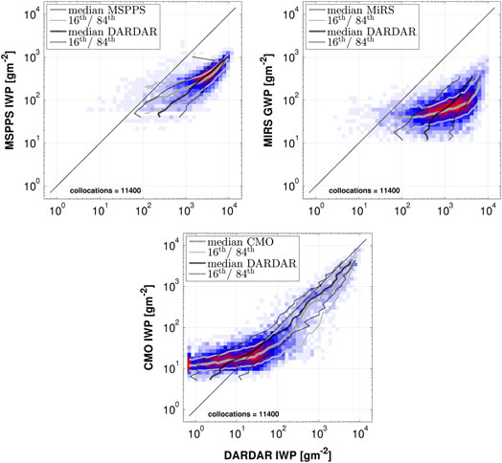
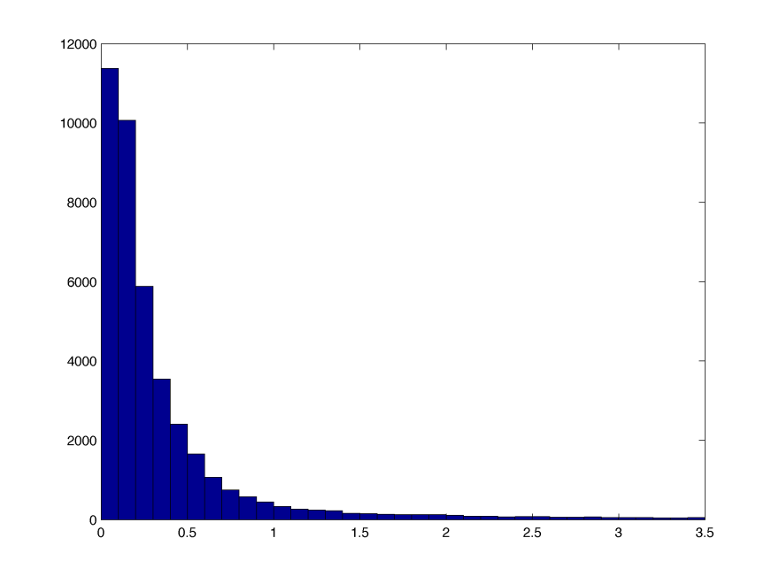
MiRS Product Assessments: Ice Water Path
IWP (mm)
MiRS v9.2
MiRS v11
MiRS v9.2 IWP ~ 10 x lower than DARDAR radar-lidar
0
3.5
IWP (mm)
MM5 simulation IWP
From Eliasson et al. (JGR, 2013)
MiRS v9.2 underestimated IWP quantities relative to ground-based measurements
MiRS v11 IWP magnitudes now more physically realistic, and agrees well with MM5 simulation
0
3.5

Slide 17
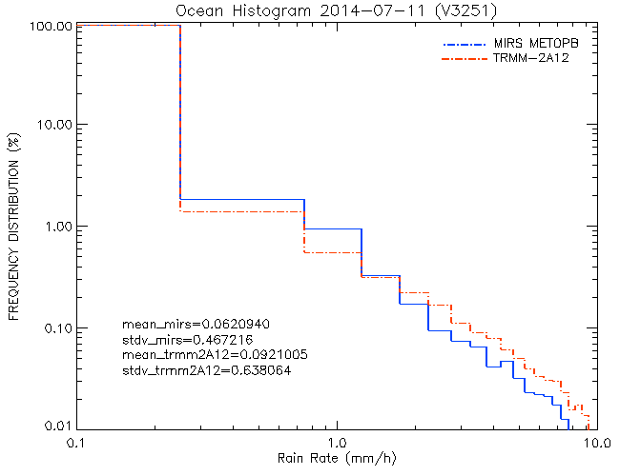
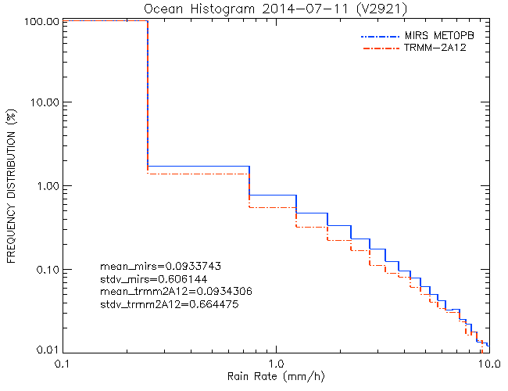
MiRS Product Assessments: Rain Rate (vs. TRMM 2A12)
MiRS MetopB HR v9.2
MiRS MetopB HR v11
Mean MiRS v9.2 = 0.06
Mean TRMM = 0.09
Mean MiRS v11 = 0.09
Mean TRMM = 0.09
MiRS v11 rain rate retrieval is now in better agreement with TRMM 2A12 as compared to v9.2 retrieval.
Sample mean and std dev between MiRS and TRMM 2A12 also in better agreement in v11 than in v9.2
2 year assessment
period (2009-2014)

Slide 18
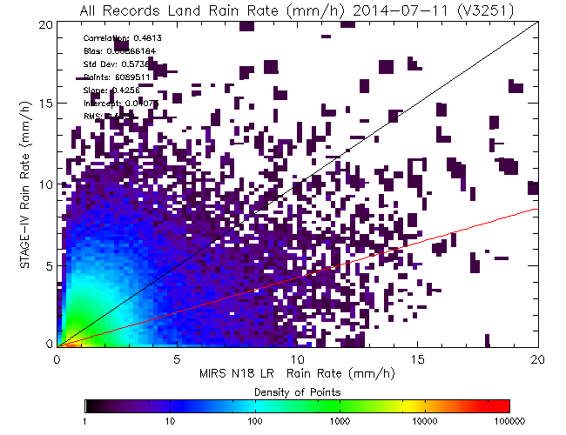
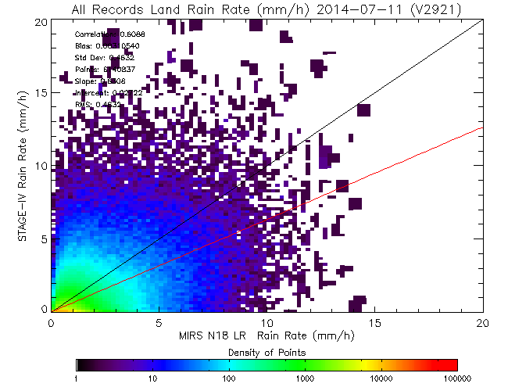
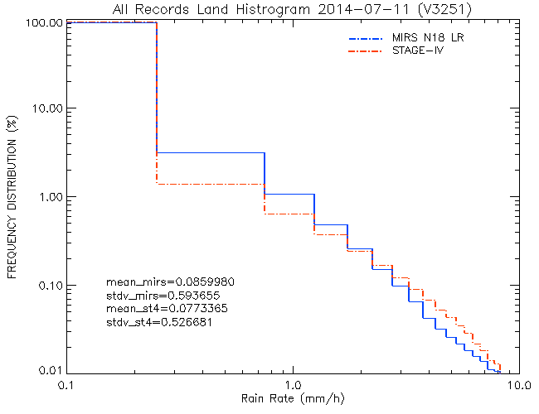
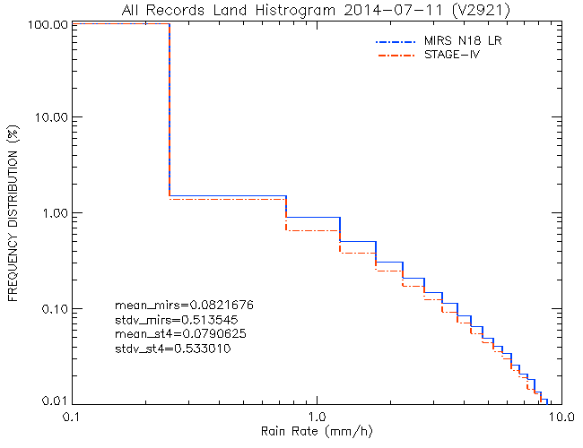
MiRS Product Assessments: Rain Rate (vs. Stage-IV gauge-radar)
MiRS N18 LR v9.2
MiRS N18 LR v11
Corr: 0.48
RMSE: 0.57
Corr: 0.60
RMSE: 0.48
Significantly improved RR in MiRS v11
Better agreement in low intensities
5 year assessment
period (2009-2014)

Slide 19
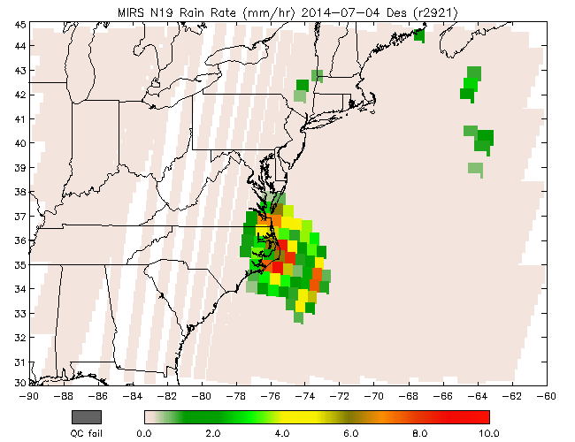
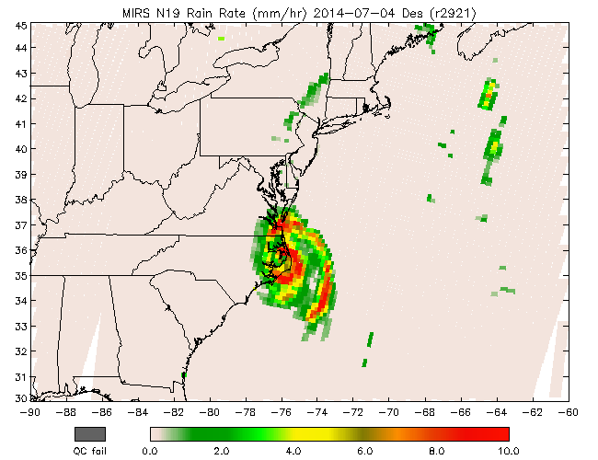
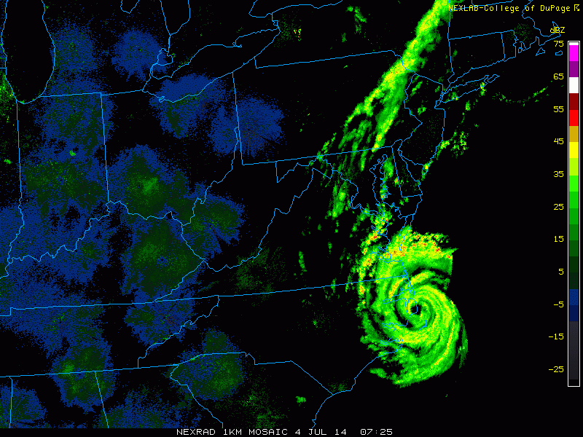
N19 LR vs. HR Rain Rate (Hurricane Arthur)
MiRS N19 LR v11
MiRS N19 HR v11
2014-07-04
NEXRAD
Small-scale precipitation features are now captured in HR with increased dynamic range
Smooth transition of rain across coastlines
Generally, in agreement with NEXRAD radar

Slide 20
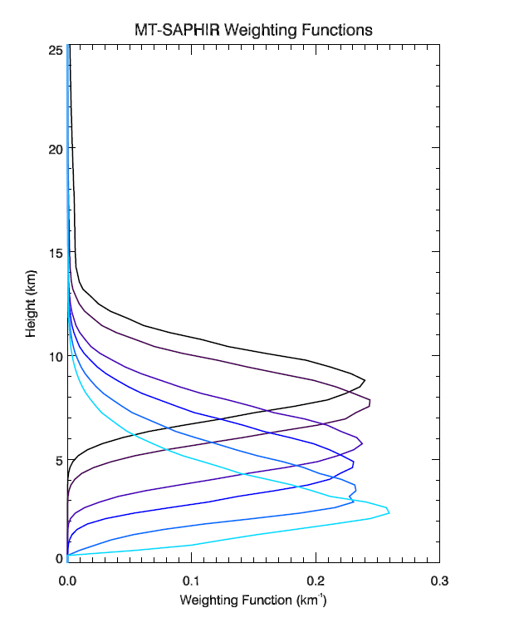
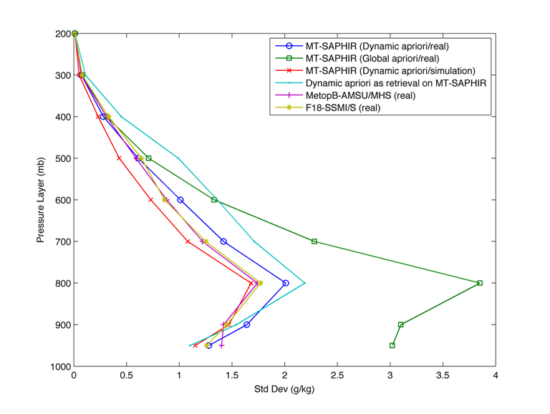
MiRS SAPHIR Water Vapor Sounding
Against ECMWF
Note lack of surface-sensitive channels
Only channel 6 has any signal from surface (mainly in dry atmospheres)
Dynamic a priori
Global a priori
Ch 1
Ch 2
Ch 3
Ch 4
Dynamic background helps the retrieval because of limited information content, especially on lower troposphere
Ch 5
Ch 6

Slide 21
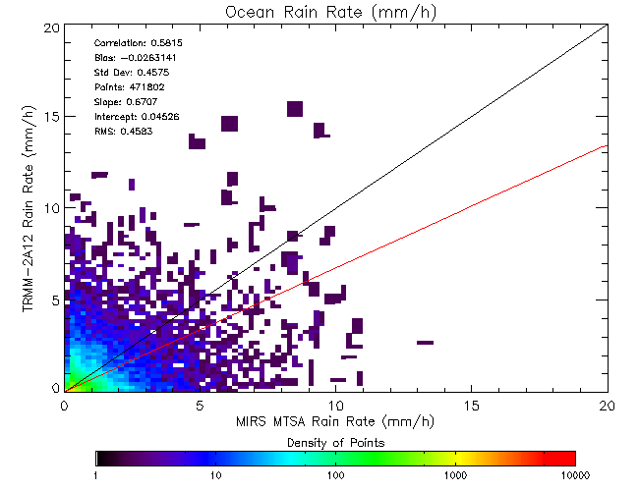
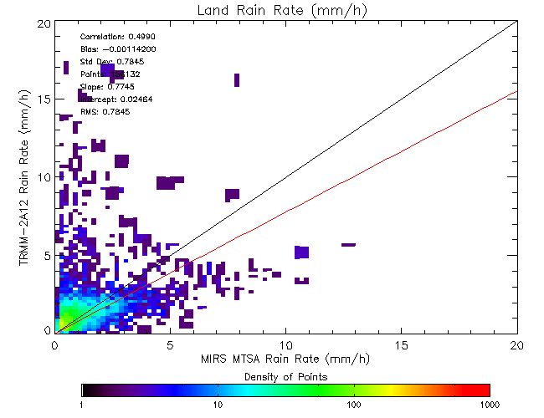
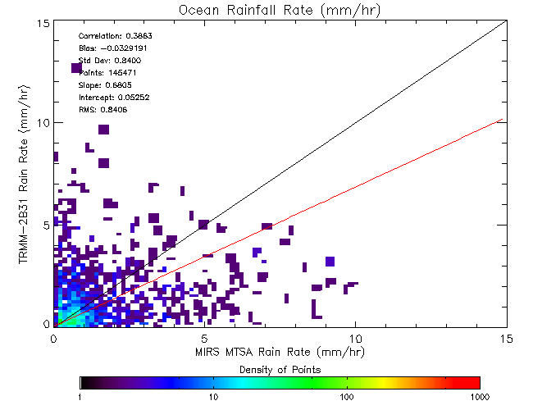
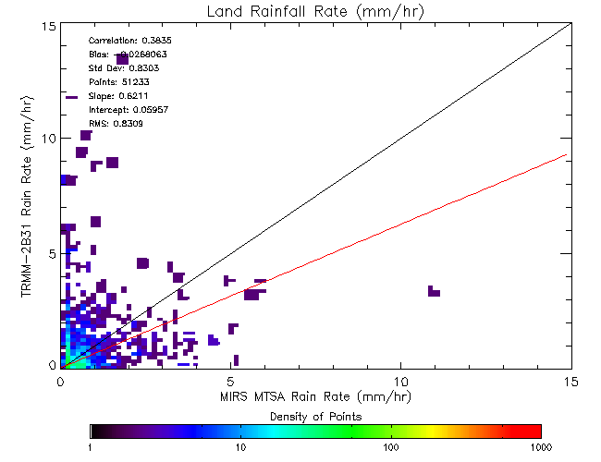
MiRS SAPHIR Rain Rate Assessment Against TRMM 2A12/2B31
2A12
2B31
Independent assessment of MiRS SAPHIR rain rate retrieval against TRMM GPROF radiometer and 2B31 radar-radiometer combined algorithms (March – August 2013 validation period).

Slide 22
AMSR2 Cryospheric products
27 October 2012
OSI-SAF Total SIC
MiRS Total SIC
OSI-SAF Ice Age
MiRS Ice Age

Slide 23
MiRS-based QC in GSI Assimilation (MIIDAPS)
1DVAR increases the number of obs assimilated for channels 5 and 7 of ATMS without degrading the O-B or O-A statistics

Slide 24
Summary
Significant updates to MiRS algorithm: improved sounding performances, improved hydrometeor and rain rate retrievals
Improvements seen across seasons/years
Extended to Megha-Tropiques/SAPHIR
Extended all operational sensors to high resolution (Now: N18, N19, MetopA, MetopB, F18, NPP/ATMS)
Extended to F17 SSMIS
Extended to GCOM-W1/AMSR2 & GPM/GMI (preliminary)
Upcoming activities
MiRS snow fall rate algorithm
New/Improved products: SWE, Snow grain size, wind speed, etc
Improved emissivity handling (dynamic background/covariance matrix)
Extension to new sensors: F19, JPSS
Validation extension
Science improvements (CRTM, core algorithm improvements)
MiRS project overview, routine monitoring, and retrieval product files available via website:
http://mirs.nesdis.noaa.gov

